Slide 1

A WARM WELCOME TO STUDENTS OF RAMANUJAN COLLEGE OF MANAGEMENT-PALWAL
30TH SEPTEMBER, 2016
https://kamleshsujata.wordpress.com
IF YOU WANT TO FLY HIGH- LIKE AN EAGLE, YOU NEED TO BE SELF DRIVEN

Slide 2





ABOUT ME
OVER 35 YEARS OF CORPORATE CITIZENSHIP
S.NO | NAME OF COMPANY | INDUSTRY
1. | MAHINDRA & MAHINDRA LTD | AUTOMOBILES, FARM MACHINERY & SPARE PARTS
2. | MAHINDRA SHUBH LABH SERVICES LTD | AGRI BUSINESS & CONTRACT FARMING
3. | ESCORTS LTD | AGRI BUSINESS, CONTRACT FARMING & GENSET
4. | RELIANCE INDUSTRIES & RETAIL | RURAL HUBS, RURAL RETAIL, WHOLESALE AND URBAN RETAIL
5. | SAS MOTORS LTD | POWER TILLER AND E-RICKSHAW
FUNCTIONAL MAINSTAYS: SALES & MARKETING, OPERATIONS, PROJECTS & START UPS.
WORKED IN MAJOR CITIES ACROSS INDIA AT SENIOR LEVELS AND ACROSS FUNCTIONS.
WRITER AND BLOGGER
EMAIL: shravancharitymission@gmail.com
https://kamleshsujata.wordpress.com
PUBLICATIONS
NOTHING HAPPENS BY CHANCE– YOU NEED TO WORK FOR IT

Slide 3
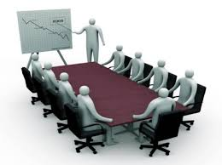
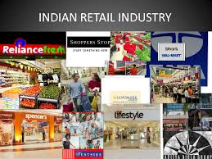
CONTENT
INDIAN RETAIL INDUSTRY
SKILL BUILDING
RISE OF INDIAN RETAIL INDUSTRY

Slide 4
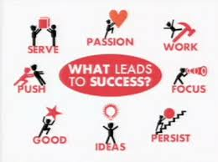
THE FOUR CIRCLES
Learn
Implement
Innovate
Training-is key
CORE CAREER MESSAGE

Slide 5


CAREER CHALLENGES
FAST PACE OF TECHNOLOGY
ENGLISH LANGUAGE
FAST PACE OF LIFE
GLOBAL REACH
GLOBAL COMPETITION
CONTINUOUS TRAINING
TO BE MULTI SKILLED
MULTI TASKING
SMART WORKING
MOBILITY
DYNAMIC ENVIRONMENT
FORCE MEAJURE
TRANSPARENCY
BUSINESS LAWS & TAXES
EXCELLENCE
ENVIRONMENT ISSUES
POLARISED SOCIETY
DISTANCE
SPREAD OF INDUSTRIES
INTELLECT & FIELD
CHALLENGES ARE FOR EVERYONE … BUT WINNERS ARE FEW

Slide 6

PERSONALITY DEVELOPMENT TIPS
Speak English (Don’t feel shy)
with colleagues, teachers,
friends & parents
while talking to Call Centres
Speak small sentences
Join English speaking course
Read English
Newspaper
Books
Social Media
A SOUND PERSONALITY IS A STRONG FOUNDATION
BLISS OF PERSONALITY
Observe your role model minutely
How they talk
Their body language
Watch English
News
Movies
Debates & talk shows
EVERY MOMENT IS A MOMENT OF PERSONALITY DEVELOPMENT

Slide 7
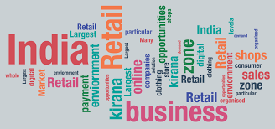
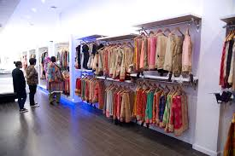
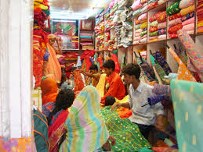
RETAIL SCENARIO IN INDIA
URBAN RETAIL
RURAL RETAIL
ONE OF THE FASTEST GROWING SECTORS OF INDIAN ECONOMY WITH A HUGE EMPLOYMENT POTENTIAL

Slide 8
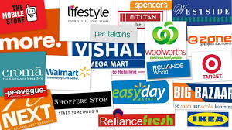
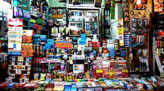
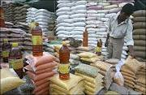
DIFFERENCE BETWEEN RETAIL AND WHOLESALE
Retailing refers to a process where the retailer sells the goods directly to the end-user for his own consumption in small quantities.
Wholesale: Business of selling of goods in large quantities and at low prices, typically to be resold by retailers at a profit.
RETAILING IS DETAILING

Slide 9
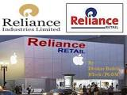
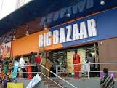





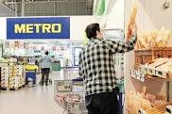
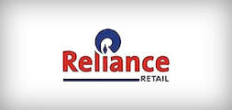
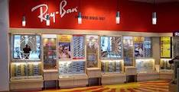
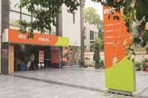




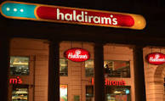
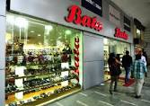
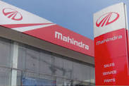




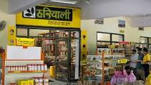

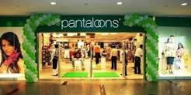
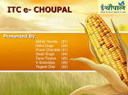

MAJOR BRANDS IN URBAN AND RURAL RETAIL
BOTH URBAN AND RURAL RETAIL MOVING TO CORPORATE BRANDS

Slide 10
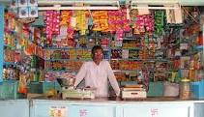
BRIEF HISTORY
Highest shop density in the world.
Around 16 million shops in the country.
Mostly of Mom & Pop variety.
As of 2003, India's retailing industry was essentially owner manned
small shops.
In 2010, larger format convenience stores and supermarkets
accounted for about 4 percent of the industry, and these were
present only in large urban centers.
India's retail and logistics industry employs about 40 million Indians
(3.3% of Indian population)
* source: Singhal Arvind; KSA Technopak
INDIAN RETAIL REQIRES STREAMLINING

Slide 11
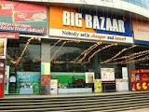
INDIAN RETAIL MARKET HIGHLIGHTS-1
Indian retail has emerged as one of the most dynamic and fast
paced industries due to entry of several new players.
It accounts for 10% of country’s GDP (gross domestic produce)
and around 8% of the total employment.
It is the fifth largest preferred retail destination globally.
Amongst the highest in the world, in terms of per capita retail
store availability.
India’s retail sector is experiencing exponential growth, in not
just the major cities and metros, but also in Tier-II and Tier-III
cities.
Healthy economic growth, changing demographic profiles,
increasing disposable incomes, urbanisation, changing consumer
tastes and preferences are the other factors driving its growth in
the organised retail market of India.
ORGANISED RETAIL BEGINNING TO CHANGE THE PSYCHE OF INDIAN CONSUMER

Slide 12
INDIAN RETAIL MARKET HIGHLIGHTS-2
Market Size
India’s retail market is expected to nearly double to US$ 1 trillion
(67 lac crores) by 2020 from US$ 600 billion (40 lac crores) in 2015.
All driven by income growth, urbanisation and attitudinal shifts.
While the overall retail market is expected to grow at 12 per cent
per annum, modern trade would expand twice as fast at 20 per
cent per annum and traditional trade at 10 %.
The Indian retail market is in its nascent stage; where
unorganised players accounted for 92 per cent of the market
during 2015
Online retail is expected to be at par with the physical stores in the
next five years.
INDIAN RETAIL MARKET IS CURRENTLY ON A HIGH

Slide 13
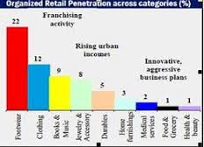
INDIAN RETAIL MARKET HIGHLIGHTS-3
India is expected to become the world’s fastest growing e-commerce market, driven by
robust investment in the sector and rapid increase in the number of internet users. 15.1%
of the Indian population uses Internet.
Indian e-commerce sales are expected to reach US$ 120 billion! (8 lac crores) by 2020
from US$ 30 billion (2 lac crores) in FY2016. Led by faster speeds on reliable telecom
networks, faster adoption of online services, flexibility of language and better variety as
well as convenience.
India’s direct selling industry is expected to reach a size of Rs 23,654 crore (US$ 3.51
billion) by FY2019-20, as per a joint report by India Direct Selling Association (IDSA) and
PHD.
The Indian retail trading has received Foreign Direct Investment (FDI) equity inflows
totalling US$ 537.61 million during April 2000–March 2016, according to the Department
of Industrial Policies and Promotion (DIPP).
WITH THE EXPLOSION OF POPULATION AND PER CAPITA INCOME THIS WILL ONLY INCREASE

Slide 14
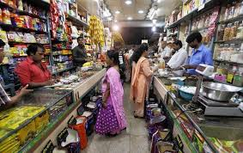
INDIAN RETAIL MARKET HIGHLIGHTS-4
Amazon India has opened six new fulfilment centres across Chennai, Coimbatore, Delhi,
Jaipur and Mumbai, which will open up 5.5 million square feet of storage space for sellers in
the marketplace who use the ‘Fulfilled by Amazon’ service.
IKEA, the world’s largest furniture retailer, plans to invest Rs 10,500 crore (US$ 1.56 billion) to
set up 25 stores across India and hire over 15,000 permanent employees and 37,500
temporary employees to assist in running its stores.
Walmart India plans to add 50 more cash-and-carry stores in India over the next four to five
years.
Government of India has allowed 100 per cent Foreign Direct Investment (FDI) in online retail
of goods and services through the automatic route, thereby providing clarity on the existing
businesses of e-commerce companies operating in India.
WORLDWIDE- INDIA IS THE THIRD LARGEST ECONOMY ON PPP AND THE FIFTH PREFERRED DESTINATION IN RETAIL

Slide 15
INDIAN RETAIL MARKET HIGHLIGHTS-5
Increased participation from foreign and private corporate players has given a big
boost to Indian retail industry. India’s price competitiveness attracts large retail
players to use it as a sourcing base.
Global retailers such as Walmart, GAP, Tesco and JC Penney are increasing their
sourcing from India and are moving from third-party buying offices to establishing
their own wholly-owned/wholly-managed sourcing and buying offices.
The Government of India has introduced reforms to attract Foreign Direct
Investment (FDI) in retail industry. The government has approved 51 per cent FDI in
multi-brand retail and increased FDI limit to 100 per cent (from 51 per cent) in single
brand retail.
REALISING THE POTENTIAL OF RETAIL- GOVERNMENT HAS TWEAKED ITS POLICIES

Slide 16
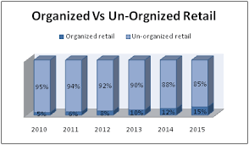
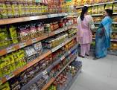
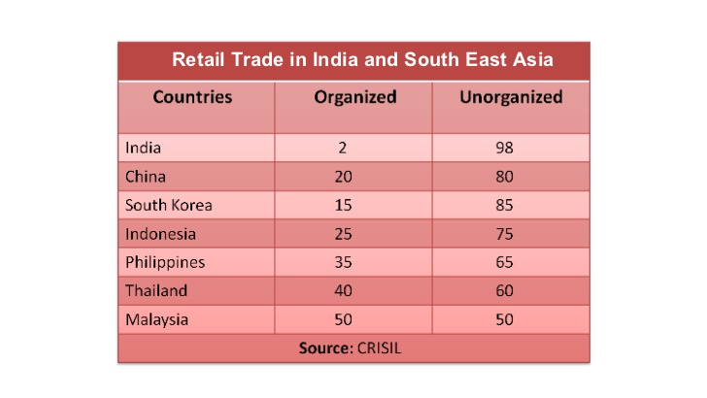
HOW BUSINESS IS DONE
HOW BUSINESS IS DONE
THERE IS A GRADUAL SHIFT FROM UNORGANISED TO ORGANISED RETAIL ACROSS COUNTRIES

Slide 17
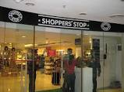
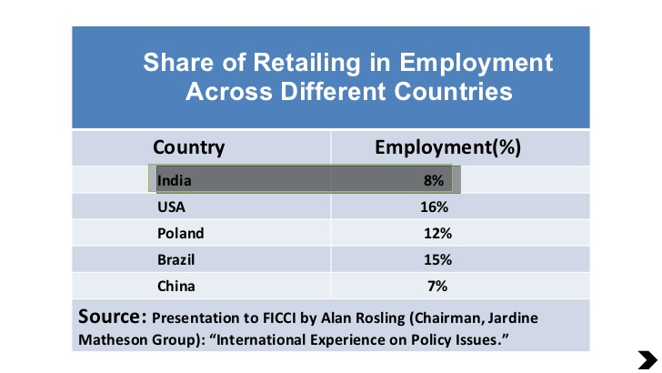
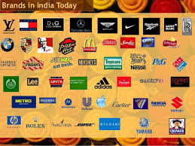
SHARE OF RETAIL- IN EMPLOYMENT
OPENING OF ORGANISED RETAIL WILL OPEN JOBS IN THE SECTOR FOR SKILLED YOUTH

Slide 18
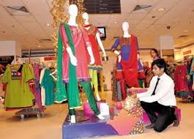
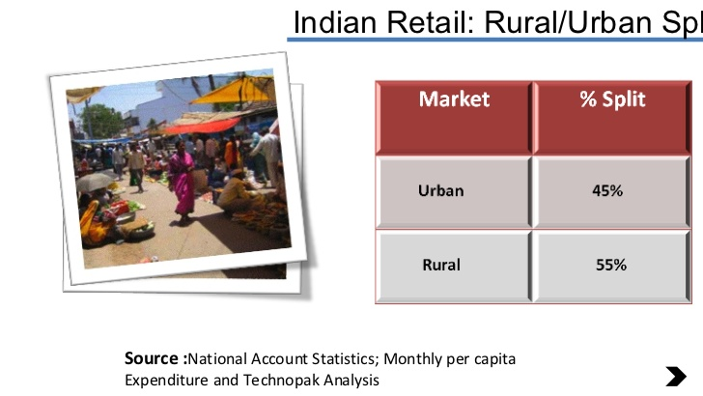
MANPOWER REQUIREMENT
MANPOWER DIVIDE
THE DISTRIBUTION IS ALMOST EQUAL, BUT RURAL JOBS WILL UPGRADE WITH SYSTEMS

Slide 19
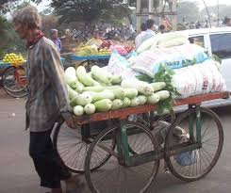
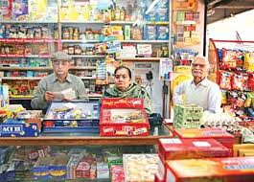
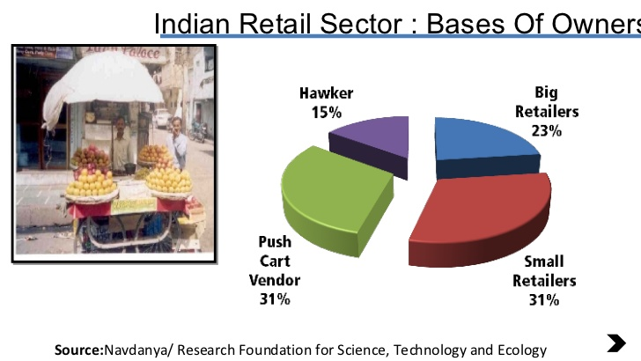
HISTORICAL DIVIDE
ALMOST A HALF-HALF DIVIDE BETWEEN MOVING AND STATIONERY RETAIL

Slide 20


THE YOUTH BRIGADE TAKES CHARGE
INDIA HAS THE WORLD’S YOUNGEST POPULATION
As of today, 66% (over 740 million) Indians are under
35 years. Out of that about 50% (over 550 million) are
under 25 years. By 2020, 61% of India’s population will
be under 35 ie. About 780 million Indians will be in this
age group.
According to the national sample survey, the literacy rate
recorded an increase of 13.17% points from 1991-2001
& literacy rate is likely to touch 75% by 2020.
YOUTH AND LITERACY ARE KEY TO ORGANISED RETAIL

Slide 21
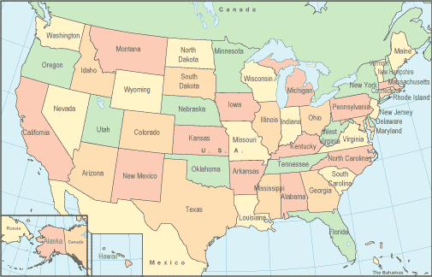
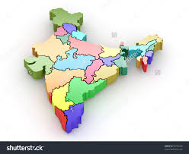
RETAIL ATTRACTIVENESS OF INDIA VS THE UNITED STATES
INDIA IS GEOGRAPHICALLY ONE THIRD THE SIZE OF THE U.S.
FOUR TIMES THE U.S. POPULATION
THIS MAKES IT A VERY ALLURING RETAIL DESTINATION
WITH HIGH DENSITY OF POPULATION PER RETAIL POINT
THIS INCREASES THE COMPETITION IN INDIAN RETAIL

Slide 22
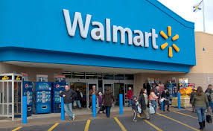
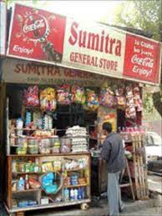

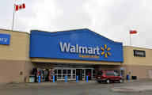
WALMART V/S INDIAN RETAIL
WALMART
The largest retailer in the world
Turnover of $ 256 bn US OPS (17 lac crores)
Average annual growth 12-13%
In 2004 net profit was $ 9000 mn
4806 stores employing 1,4 mn
people
1355 stores outside US
Average size of Walmart store is
85000 sq ft
Average turnover of a store is #51
mn
Turnover/employee is $ 175000
INDIAN RETAIL
Country of ‘Dukankars’
16 million stores employing
3.95 million people
4% stores are larger than
500 sq ft
Average Indian retailer
turnover is Rs 186075
‘THERE IS ONLY ONE BOSS, THE CUSTOMER’—SAM WALTON (FOUNDER WALMART)
Notes:
Indian turnover is 795000 crores

Slide 23
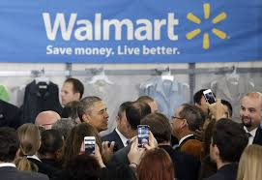
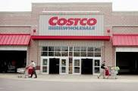
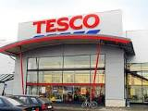
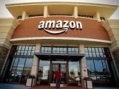
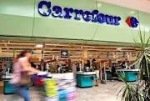
TOP 10 RETAILERS OF THE WORLD
The companies are ranked according to sales figures reported in financial statements for the most recent fiscal year end.
Wal-Mart Stores, Inc.
Costco Wholesale Corporation.
Kroger Company.
Walgreens Boots Alliance, Inc.
Tesco PLC.
Carrefour SA.
Amazon.com, Inc.
Metro Group AG.
The Home Depot, Inc
The target Corporation
DOMINATED BY U.S.A
Notes:
Indian turnover is 795000 crores

Slide 24
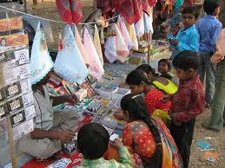
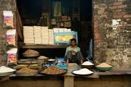
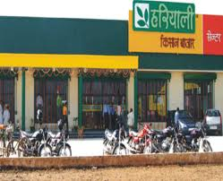
RURAL RETAIL BUSINESS OVERVIEW
Rural India consists of 720 million consumers across
627,000 villages
17% of these villages account for 50% of the rural
population and 60% of the rural wealth, implying
50% of the rural opportunity exists in 100,000+ villages
THERE IS NEED TO CONNECT WITH LAST MILE MARKETS & CONSUMERS

Slide 25
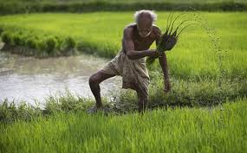

IMRB SURVEY—MAIN FINDINGS
75% OF WHAT THE FARMER REVENUES IS REDEPLOYED IN FARMING

Slide 26


CHANGING CUSTOMER EXPECTATIONS
VALUE
Pre-’80s
Price
Mid-’80s
Quality / Price
1990s
Quality + Enjoyment / Price + Time
2000s
Quality + Enjoyment + Entertainment / Price + Time + Energy
DIL MANGE MORE

Slide 27


CAREER CHALLENGES IN URBAN & RURAL RETAIL
To keep yourself motivated
Customer dealing
IT systems and procedures
Continuous training
Store profitability
Smiling face
High level of energy
To be always properly and pleasantly attired
Remote locations especially in R Retail
High voltage action during holiday
seasons
Good grasp on various products
Frequent change of assignments
Stiff targets
HIGH LEVEL ENERGY, FOCUS AND SELF TRAINING IS THE KEY

Slide 28


COMMITMENT >>>COMPETENCE CHART
COMMITMENT
C
O
M
P
E
T
E
N
C
E
LOW COMMITMENT LOW COMPETENCE | HIGH COMMITMENT LOW COMPETENCE
LOW COMMITMENT HIGH COMPETENCE | HIGH COMMITMENT HIGH COMPETENCE
(LCLC)
(HCLC)
(LCHC)
(HCHC)
ALWAYS TRY AND BE HERE
NEVER BE IN LCLC-TRY AND BE IN HCHC

Slide 29



CHALLENGES IN URBAN & RURAL RETAIL BUSINESS
High rental cost
High electricity & maintenance cost
Gestation period—deep pockets
High attrition rate
High rate of pilferage by customers
High rate of pilferage by staff
High maintenance cost of display area
High stocking costs
Fast changing technology
Spread of brands
Spread and depth of SKUs
Market research
Competent & qualified staff
Hygiene issues
Expired stocks
IT system
Product display
Discounts & schemes
ENTICING CUSTOMER TO PURCHASE IS THE BIGGEST CHALLENGE

Slide 30



VITAL POINTS WHILE DECIDING ON A LOCATION
Least flexible of strategic retailing issues.
Cost
Location of the target market
Kinds of products being sold
Availability of public transportation
Customer characteristics
Competitors location
Relative ease of traffic flow, including pedestrian
Parking and major thoroughfares
Complementary stores
LOCATION SHOULD BE HASSLE FREE FOR THE CUSTOMER

Slide 31



SIX LEVELS OF MERCHANDISE HIERARCHY
Store- The first level of the merchandise hierarchy is the store. Before merchandise can be sold, either in a brick-and-mortar location or an online store, the customer needs to reach the store.
Department- The second level of merchandise hierarchy is the department level. When the customer arrives at the store, specific departments contain the merchandise. For example, if a customer enters the store and needs an extension cord, he goes to the hardware department.
Classification- The third level of the merchandise hierarchy is the classification of the item. So, if a customer in the hardware department needs an extension cord, she goes to the extension cord area of the department.
Sub-Classification-Sub-classification is the fourth level of the merchandise hierarchy. When the customer sees the extension cords, he realizes there are indoor extension cords and outdoor extension cords. If he needs an indoor extension cord, he goes to the next level of the hierarchy.
Styles- The fifth level of the hierarchy is the style of the merchandise. In this case, the customer sees there are 4-foot extension cords, 6-foot extension cords and 10-foot extension cords. Needing a 6-foot extension cord, she moves to the final level of a six-level merchandise hierarchy.
Pricing- The last level of the merchandise hierarchy is the pricing level. The customer finds three different 6-foot extension cords available and makes his decision based on the price points.
.
METHOD OF ARRIVING AT THE FINAL PRODUCT

Slide 32



TYPES OF MERCHANDISE A RETAIL STORE MUST CARRY
.
Destination Merchandise
Image Enhancer– 10% of total merchandise
Transaction builder
Traffic builder– They create frenzies
Profit generator
Turf protector
BASIC GUILDELINES FOR INVENTORY MANAGEMENT

Slide 33


PRODUCT BREADTH, DEPTH & ASSORTMENT…
In the retail industry, product breadth is the variety of products that a store offers. A good selection of merchandise is key to attracting and keeping customers, no matter what type of products you sell. Finding a balance between product breadth, depth, and the merchandise mix will be key to your store's success, but first, you need to understand what it all means. These are the fundamentals of retail inventory strategy and if you begin with a clear understanding of it, you will find it helpful for years to come.
What is Product Breadth?
In its most basic definition, product breadth is the variety of product lines that a store offers. It is also known as product assortment width, merchandise breadth, and product line width.
For instance, a store may only stock 4 items of each SKU, but their product breadth (the variety) may consist of 3,000 different types of products.
What is Product Depth?
The other part of the retail inventory equation is product depth (also known as product assortment or merchandise depth). This is the number of each item or particular styles that you carry of a particular product.
For instance, a store may strategize that to keep inventory costs down, they will have a shallow product depth. This means they might only stock 3-6 SKUs of each product in the store.
PRODUCT BREADTH AND DEPTH-- SALES DRIVERS

Slide 34


… PRODUCT BREADTH, DEPTH & ASSORTMENT
.
Product Breadth + Product Depth = Product Assortment
The product breadth is the number of product lines, while the product depth is the variety within each of those lines.
These two elements combine to make up the store's product assortment or merchandise mix.
Speciality retailers will likely have a smaller product breadth than a general merchandise store. This is because their products have a narrower focus and specific niches. However, they may have an equal, if not wider, product depth if they choose to stock a greater variety of each product line.
A candle store, for example, will have a smaller variety (or breadth) of products than a corner drug store, even if they have the same number of products in inventory.
The candle store stocks only 20 varieties of candles (the breadth), but they may stock 30 colors and scents (the depth) of each of those candles.
The corner drug store stocks 200 different products (the breadth), but may stock only 1 or 2 variations, brands or styles (the depth) of each product.
PRODUCT ASSORTMENT REQUIRES CONTINUOUS MONITORING

Slide 35




PRINCIPLES OF STORE DESIGN
A retail store has one goal and one goal only: to get consumers over the threshold of a store, and influence them to part with their cash.
Eye catching visual merchandising.
Slow down the customer journey in the store.
Mark out the customer pathway around the store.
Steer customers to the right of the store.
Be bold creative and innovative with store design.
Aerate the store design and layout.
Make the most of any shop space.
.
THE ULTIMATE TEST IS MAKE THE CUSTOMER ENJOY AND SPEND

Slide 36

PRINCIPLES OF STORE DESIGN
Planograms, also known as plano-grams, plan-o-grams, schematics and POGs, are visual representations of a store's products or services. They are considered a tool for visual merchandising. According to the Oxford Dictionary, “It is a diagram or model that indicates the placement of retail products on shelves in order to maximize sales.” Planograms therefore help dictate a retail store's layout. The ultimate effectiveness of the planogram can be measured by sales volume.
THE ULTIMATE TEST OF A GOOD PLANOGRAM IS THE SALES VOLUME

Slide 37


APPROX SIZE OF STORES & SKUs
S.NO | TYPE OF STORE | APPROXIMATE AREA |  | NO OF SKUs
 |  | ( SQ FT)
1 | MOM & POP STORES | 500 |  | 5000
2 | DISCOUNT STORES | 500 |  | 1000
3 | DEPARTMENT STORES | 2500 |  | 40000
4 | SUPER MARKETS | 10000 |  | 100000
5 | e-STORES | 0 |  | 60000000
SIZE HAS A DIRECT BEARING WITH SKUs

Slide 38



EVERY COLOUR HAS SOMETHING TO SAY…
.
COLOURS PLAY A BIG ROLE IN CUSTOMER BUYING BEHAVIOUR

Slide 39




… EVERY COLOUR HAS SOMETHING TO SAY
.
COLOURS PLAY A BIG ROLE IN CUSTOMER BUYING BEHAVIOUR

Slide 40



JOB OPPORTUNITIES IN URBAN RETAIL
.
Supply chain
Cashier
Accounts
IT
Store maintenance & upkeep
HR
Merchandiser
Store assistants
Sales associates
Store Manager
Market communications
MOST JOBS REQUIRE HIGH SKILL LEVELS

Slide 41



TYPES OF RETAIL OUTLETS …
Department Stores. A department store is a set-up which offers wide range of products to the end-users under one roof. ...
These can be further segmented into
Discount Stores. ...
Supermarket. ...
Warehouse Stores. ...
Mom and Pop Store (also called Kirana Store
in India) ...
Department stores
Dollar stores
Speciality Stores ...
Malls. ...
E Tailers
INDIAN RETAIL HAS EVOLVED INTO MULTI FACETED PLANOGRAMS

Slide 42


… TYPES OF RETAIL OUTLETS
DISCOUNT STORES-
They generally offer a limited range but liberal quantities.
Quality in certain cases might be a little inferior as compared to department stores.
Wal-Mart currently operates more than 1300 discount stores in United States. In
India Vishal Mega Mart comes under discount store.
Merchandise: Almost the same as department store but at a cheaper
price.
A PLATFORM FOR WHOLESALE AS WELL AS RETAIL

Slide 43


… TYPES OF RETAIL OUTLETS
SUPERMARKET:
A retail store which generally sells food products and complete range of household items,
properly placed and arranged in specific departments is called a supermarket.
A supermarket is an advanced form of the small grocery stores and caters to the household
needs of the consumer.
The various food products (meat, vegetables, dairy products, juices etc) are all properly
displayed at their respective departments to catch the attention of the customers and for
them to pick any merchandise depending on their choice and need
Medicines
Vegetables
Fruits & Vegetables
Soft drinks
Frozen food
Canned Juices
Spiritual
Household
Furnishings
Merchandise:
Bakery products
Cereals
Meat Products, Fish products
Breads
Furniture
White goods
Electronics
MULTI FLOORED, IN LACS OF SQUARE FEET WITH LACS OF SKUs AND WIDTH OF BRANDS

Slide 44
… TYPES OF RETAIL STORES
Mom and Pop Store (also called Kirana Store in India)
Mom and Pop stores are the small stores run by individuals in the
nearby locality to cater to daily needs of the consumers staying in the
vicinity.
They offer selected items and are not at all organized.
The size of the store would not be very big and depends on the land
or shop available to the owner. They wouldn’t offer high-end products.
Merchandise:
Eggs
Bread
Stationery
Toys
Cigarettes
Cereals
Grocery
Pulses
Medicines
THESE ARE FRONT LINE STORES LOCATED IN COLONY MARKETS

Slide 45



… TYPES OF RETAIL STORES
Department Stores
A department store is a set-up which offers wide range of products
to the end-users under one roof
In a department store, the consumers can get almost all the
products they aspire to shop at one place only
Department stores provide a wide range of options to the
consumers and thus fulfil all their shopping needs
Merchandise:
Electronic Appliances
Apparels
Jewellery
Toiletries
Cosmetics
Footwear
Sportswear
Toys
Books
CDs, DVDs
Examples - Shoppers Stop, Pantaloon
Furniture
Household
White goods
DEPARTMENTAL STORES ARE WIDE SPREAD ON BRANDS AND SKUs

Slide 46


… TYPE OF RETAIL STORES
Dollar Stores
Dollar stores offer selected products at extremely low rates but here the
prices are fixed.
Example - 99 Store would offer all its merchandise at Rs 99 only. No further
bargaining is entertained. However the quality of the product is always in
doubt at the discount stores.
NO BARGAIN STORES

Slide 47



…TYPES OF RETAIL STORES
Malls
Many retail stores operating at one place form a mall.
A mall would consist of several retail outlets each selling their own
merchandise, but from a common platform.
MALLS ARE THE BEHEMOTHS OF THE MODERN DAY RETAIL

Slide 48


… TYPES OF RETAIL STORES
Speciality Stores
Speciality store specialises in a particular product
They don’t sell anything else than specific range of goods
They sell only selective items of one particular brand to the consumers
and primarily focus on high customer satisfaction.
Example: You will find only Reebok merchandise at Reebok store and
nothing else. You can never find Adidas shoes at Reebok outlet.
LARGELY COMPANY OWNED OR BRAND SPECIFIC STORES

Slide 49


… TYPES OF RETAIL STORES
Warehouse Stores
A retail format which sells limited stock in bulk at a discounted rate is called as warehouse store. Warehouse stores do not bother much about the interiors of the store and the products are not properly displayed.
NO FRILLS STORE

Slide 50
…TYPES OF RETAIL STORES
E Tailers
Now a days the customers have the option of shopping while sitting at their homes.
They can place their order through internet, pay with the help of debit or credit cards and the
products are delivered at their homes only.
However, there are chances that the products ordered might not reach in the same condition
as they were ordered.
This kind of shopping is convenient for those who have a hectic schedule and are reluctant to
go to retail outlets.
In this kind of shopping; the transportation charges are borne by the consumer itself.
Example: EBAY, Rediff Shopping, Amazon
THE MODERN NET SHOPS

Slide 51

AGRI BUSINESS & RURAL RETAIL
FARMING: OUTPUT
CROP HARVEST
PROCESSING
POST HARVEST SERVICES
MARKET
ROI OF FARMER
CHICKEN BROILER SALE
MILK SALE
FARMING: INPUT
SEEDS
FERTILIZERS
PESTICIDE
IRRIGATION
FARM MACHINERY
MANUAL LABOUR
CROP FINANCE
CROP INSURANCE
ANIMAL FEED
-DAIRY FARMING
- POULTRY FARMING
INTEGRATION OF RURAL CHAIN TO MAKE IT SEAMLESS AND EFFICIENT
--RURAL BUSINESS HUB--
RURAL BUSINESS HUBS- PRODUCTS
FARM MACHINERY AND TUBEWELLS
SEEDS |  |  |  | UTENSILS
AGRI INPUTS |  |  |  | COMPUTERS
HOUSEHOLD GOODS |  |  |  | BOOKS & STATIONERY
ELECTRONICS |  |  |  | GROCERY
CLOTHES & LINEN |  |  |  | MILK & VEGETABLES
RURAL BUSINESS HUB-SERVICES
LEGAL SERVICES
ANIMAL HUSBANDRY
CROP LOANS
WAREHOUSING
AGRI BUSINESS INTENDS TO INTEGRATE BOTH RURAL LIVING AND LIVELIHOOD

Slide 52
THANK YOU

